Slide 1
BLOCKCHAIN PROJECT
Submitted by: Group 7
Anshita Khurana B2019006
Debasmita Mishra B2019015
Ridhi Khurana B2019039
Shashank Jain B2019042

Slide 2
Problem Statement
01
Building a Blockchain for Indian Government using PAN Card number of both the parties in the transaction to track and make the transaction more secure.
02
Indian government wants to come up with a new cryptocurrency (Indian coins)
A
B
PAN Card
PAN Card

Slide 3
Challenges
Personal Information can’t be tracked
Performance and Scalability challenges
1
7
2
Possibility of tax evasion
Skillset and Awareness related challenges
8
Highly Volatile
Security, Privacy and regulation challenges
3
9
4
No uniformity in laws regarding cryptocurrencies
Legal Challenges
10
5
Excessive security threats
Hostility of the industry
11
6
Manual data entry mistakes
Block size restrictions and lot of anonymity
12

Slide 4
Objective
Ç
Our solution provides a private, enterprise chain developed specifically for government. It features the ability to assign different levels of access to authorized users, having PAN Card ensuring independent validation of transactions and operations that establish full security and accountability while complying with relevant privacy standards.
Our solution enables citizens, residents, and businesses to participate and manage their data, creating a secure system that will streamline government-citizen interaction, while securing information against hacking and fraud.

Slide 5
Benefits of Including PAN Card in a transaction
Reducing cost & improving efficiency
Identity Management
Reduce potential for corruption & Abuse
Smart Regulation
Increase trust in Government and online civil systems
Asset Management & Process Tracking
Cybersecurity & Protecting Sensitive Data
Budgeting and
Financial Management

Slide 6








Business Model (Innovation)
Both parties should have a valid PAN card
Started the mining with 5 zeros
Track the personal information of both the parties involved in the transaction
P2P Network of four servers (9006, 9015, 9039, 9042)
Using SHA 512 hashing algorithm
Generated a sequence for the amount in random order of 10, 15, 25, 40,50

Slide 7
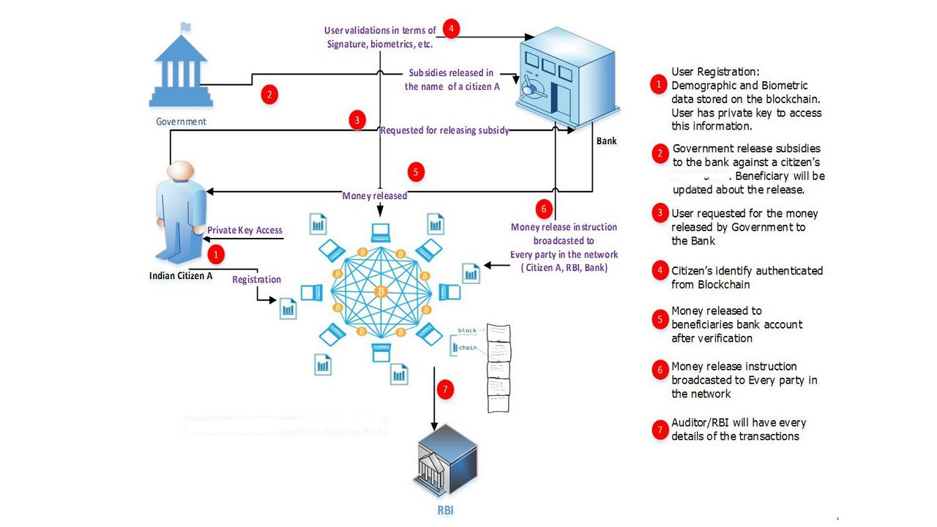
PAN Card Based Blockchain
PAN Card

Slide 8
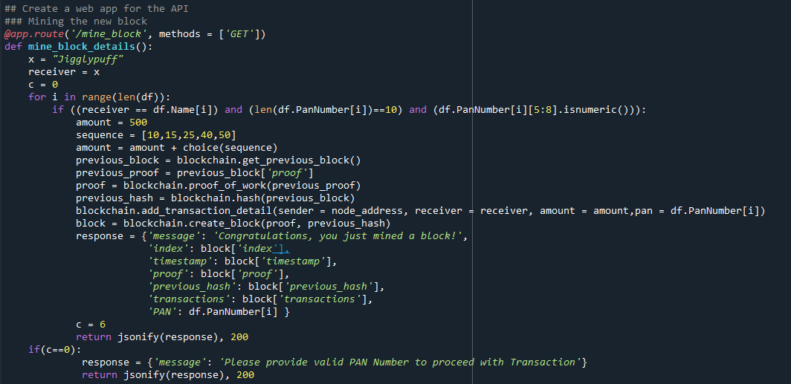
Blockchain Mining

Slide 9
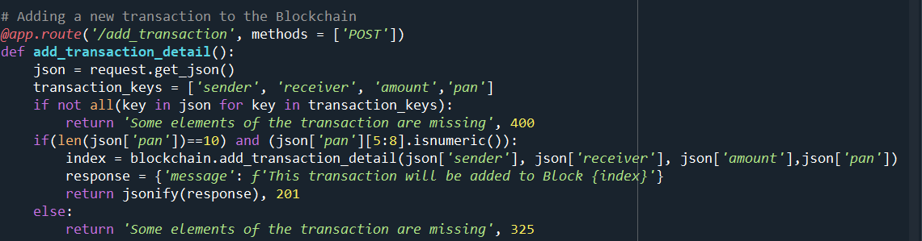
Transaction

Slide 10
SWOT Analysis
Distributed resilience and control
Decentralized network
Open source
Security & modern cryptography
Native asset creation
Dynamic and fluid value exchange
Lack of ledger interoperability
Customer unfamiliarity and poor user experience
Lack of hardened/tested technology
Wallet and key management
Immature scalability
Skills scarcity and cost
Lack of trust in a new technology suppliers
S
Strengths
W
Weakness
Reduced transaction costs
Business process acceleration and efficiency
Reduced fraud
Reduced systemic risk
Monetary democratization
New Business enablement
Legal jurisdiction barriers
Politics and hostile nation-state actors
Technology failures
Institutional adoption barriers
Divergent blockchains
Ledger conflicts/competition
Poor governance
O
Opportunity
T
Threats

Slide 12
Potential Blockchain applications of National interest include
Transfer of Land Records (Property Record Management)
Identity management
Electronic Health Record Management
Digital Certificates Management (Education, Death, Birth, agreements, sale deeds …)
Digital Evidence Management System
Power distribution
Pharmaceutical supply chain
Duty payments
IoT Device Management and Security
e-Notary Service (Blockchain enabled e-Sign Solution)
Agriculture and other supply chains
Vehicle lifecycle management
Farm Insurance
eVoting
Microfinance for Self-Help Groups (SHG)

Slide 13
Conclusion
Ç
With India’s increasing focus towards digitization, the scope of Blockchain in India only seems to be growing.
Indian economy is witnessing a paradigm shift – from cash to cashless mechanisms such as UPI, Paytm, and Google Pay.
Blockchain integration in financial transactions will not only save time and money, but also make the processing and authentication process much more seamless.

Slide 14
THANK YOU!

